Slide 1
US COUNTY PERFORMANCE
Student Name

Slide 2
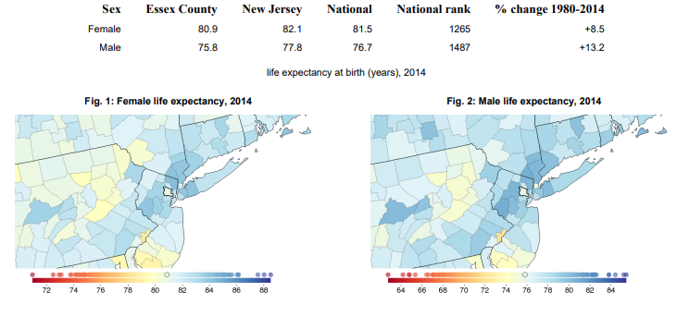
SDoHs- Life Expectancy

Slide 3
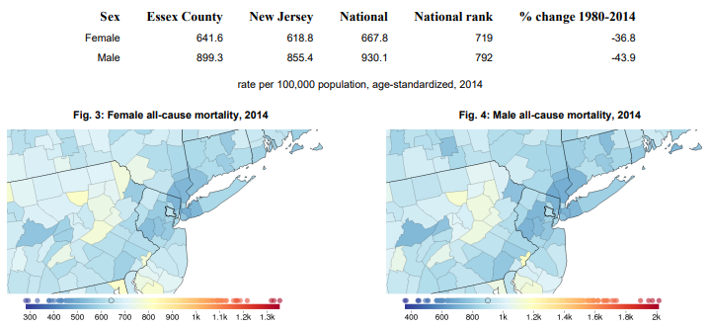
All-cause mortality

Slide 4
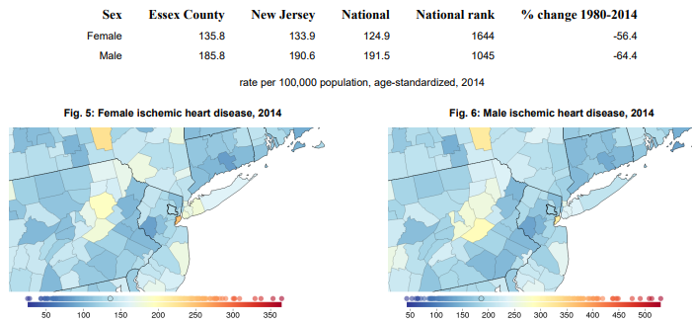
Ischemic Heart Disease

Slide 5
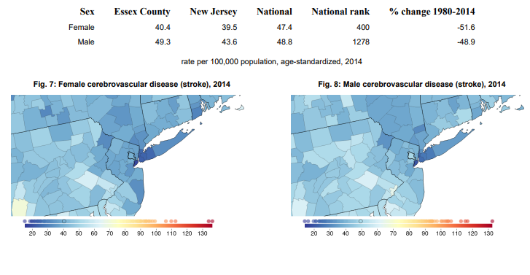
Cerebrovascular Disease (Stroke)

Slide 6
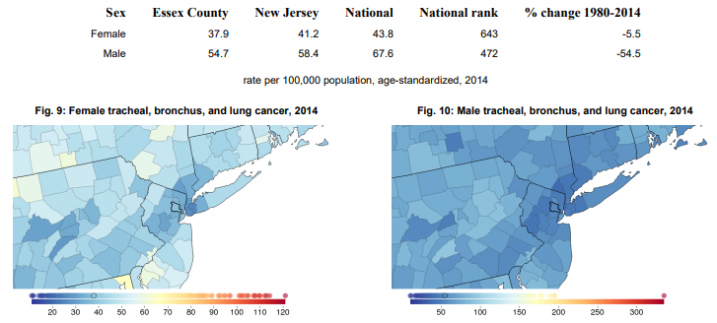
Tracheal, Bronchus, And Lung Cancer

Slide 7
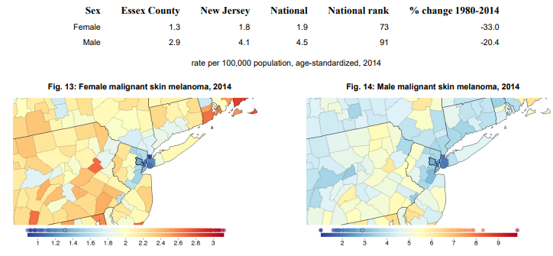
Malignant Skin Melanoma

Slide 8
Action plan
Create a change team
Problem definition
Define the Aim(s) of Your Team’s Intervention
Design the intervention

